Slide 1
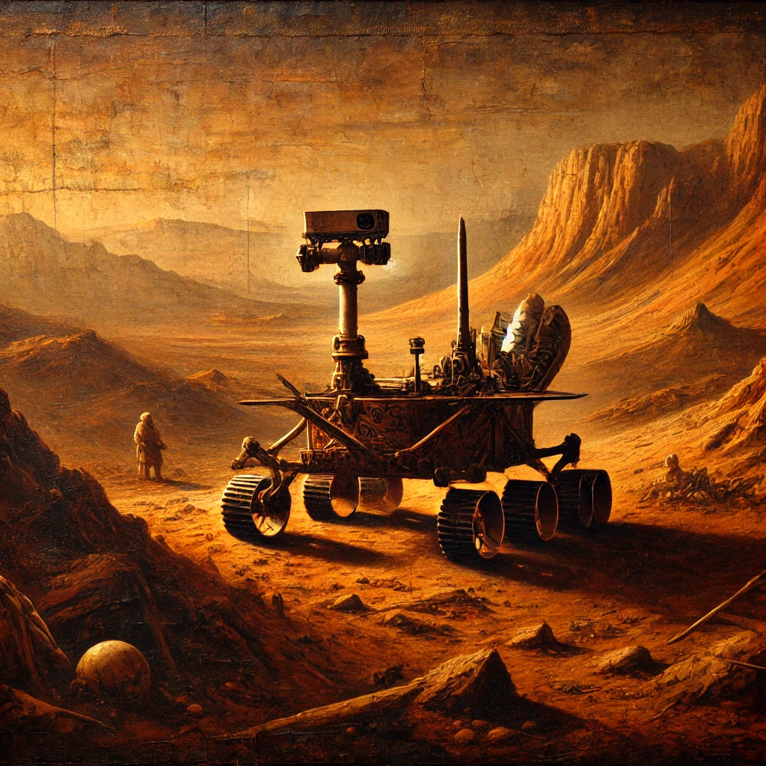
Simple stupid Rover
Thomas, Robbe, Adam

Slide 2
S.S.R.
As humanities interest in Mars grows, an understanding of its weather is needed. One of the greatest challenges that the planet provides are the frequent dust storms.
This project will try to monitor the weather phenomenon (such as temperature, humidity, light, ...) to predict such storms.
(so good! I think we can say that !!!)

Slide 3
The vision of mars rover
power efficient to last long on harvested energy
low power communication including BLE & LoRa
Environment measurements (°C, RH, LUX)
Anomaly detection (gyro)
energy awareness is an important key stone of our system as it relies on harvested energy.

Slide 4
MVP
The MVP (Minimal Vital Product) contains the following items:
- LoRa module connection that transmits data.
- Dashboard to review received data.
- The ability to measure temperature and humidity.
- Only measure when there is enough energy available.

Slide 5
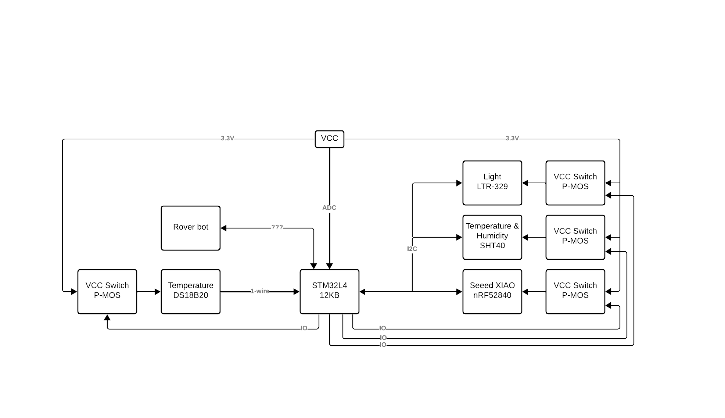

Slide 6
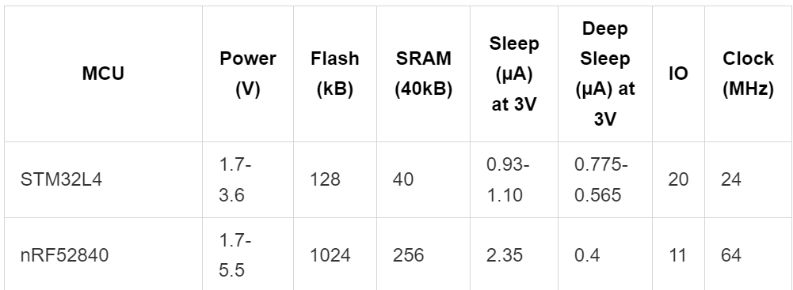
STM32L4 VS nRF52840

Slide 7
We could probably just say this
STM32: Sleep mode is supply current in stop mode 2 with RTC enabled & RAM retention (p. 99)
STM32: Deep Sleep is in Standby mode with RTC enabled & no RAM retention (p. 105).
nRF52840: Sleep mode RAM is retained and an internal clock/ interrupt is used (p. 56).
nRF52840: Deep Sleep mode RAM is NOT retained and external interrupt is needed (p. 56).
Conclusion: We continue with STM32L4 which has the ability to use the FLASH as EEPROM where this is not usable in nRF52840 (PROGMEN is read-only so not an option). With the usage of EEPROM, we can store the data before entering deep sleep and after the wake-up or reset it can fetch the data or add data to it if needed. This is not the case for nRF52840, although, it has better current consumption in Deep Sleep.

Slide 8
Team Division
Adam
enviromental sensing
Energy output managment
Robbe
BLE
Energy Profiling
Thomas
Gyroscope
LoRa
Dashboard

Slide 9
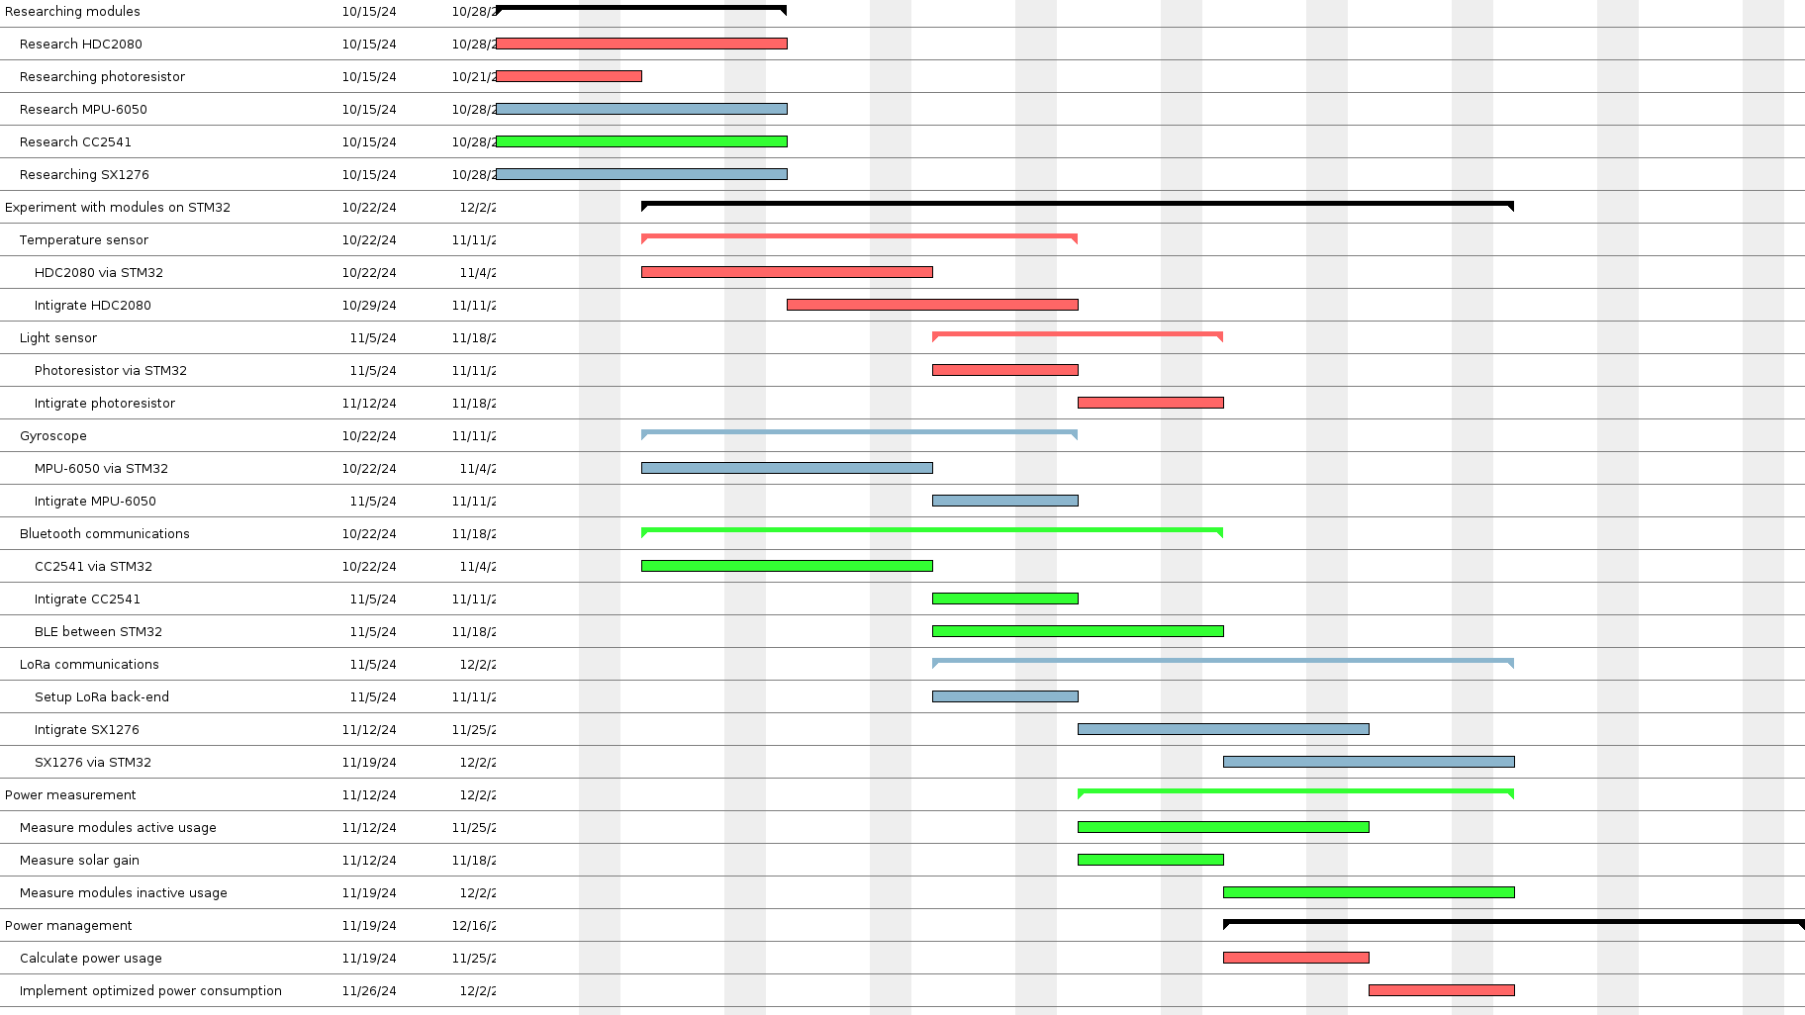

Slide 10
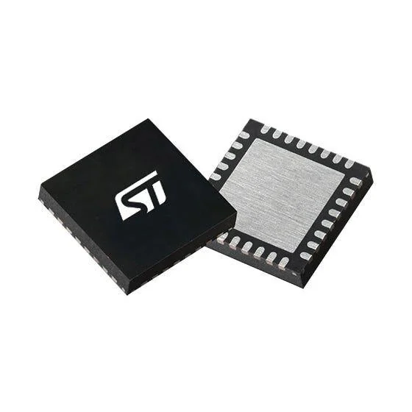
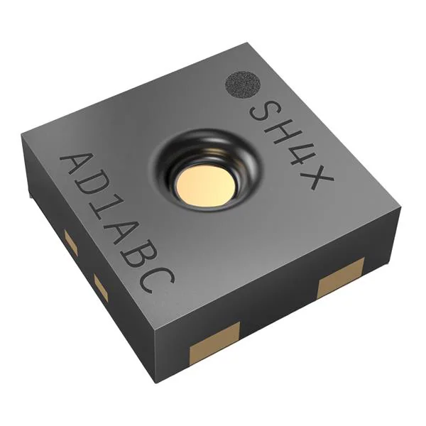
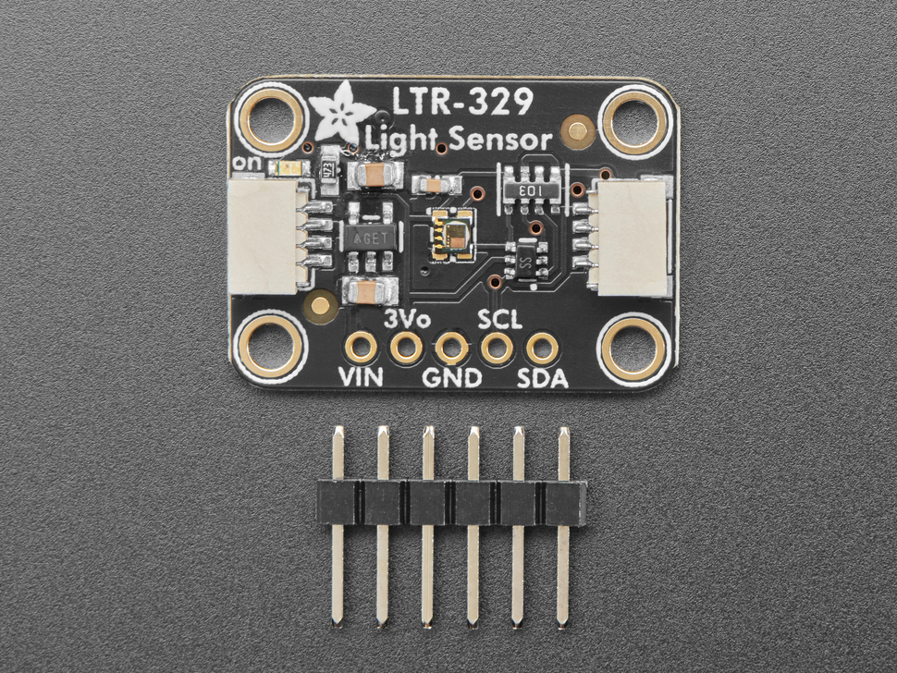
Sensing
asd

Slide 11
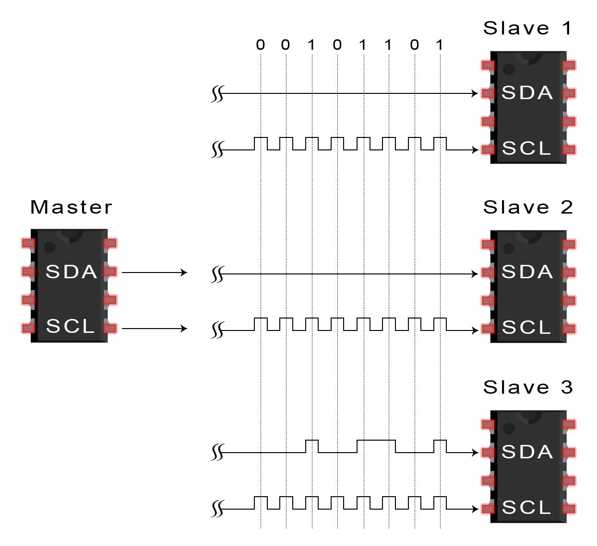
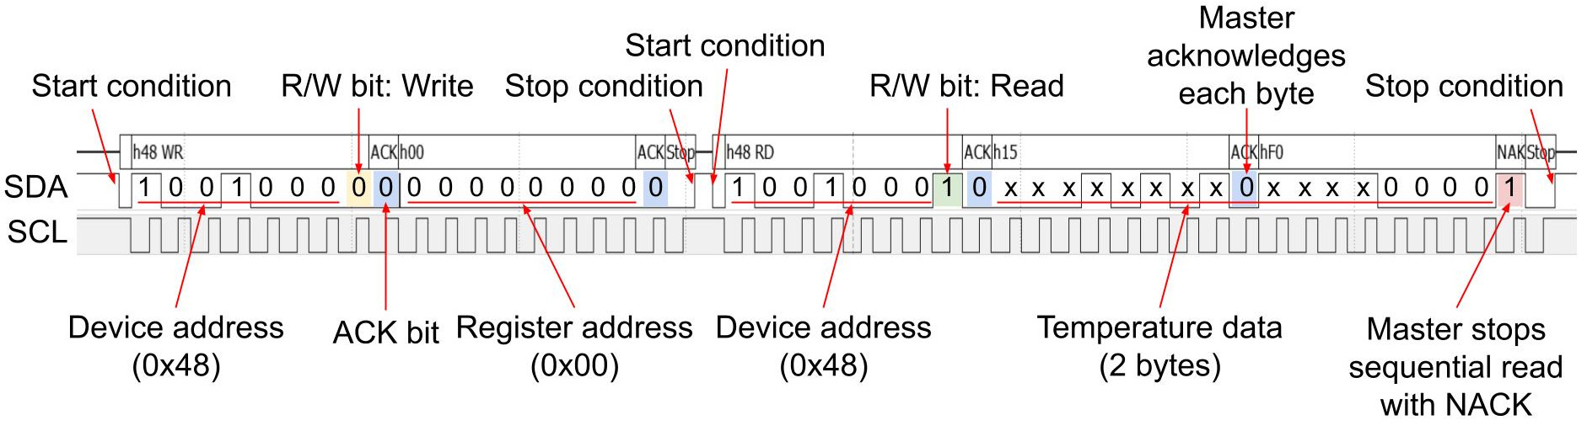
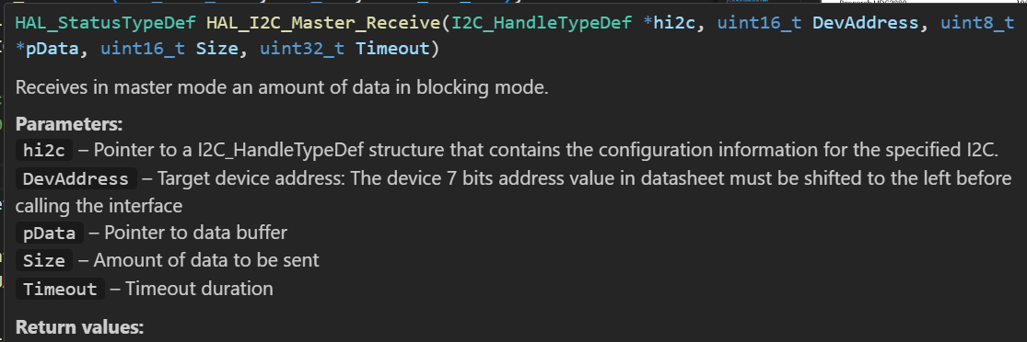
I2C
Overall i would probably just talk about the ideal way of sensing and how it should be done,
Then i would like mention that its my firs time doind I2C communication and then i could show my code that will hopefully whork by then.
I could also mention the photo resistor idea

Slide 12
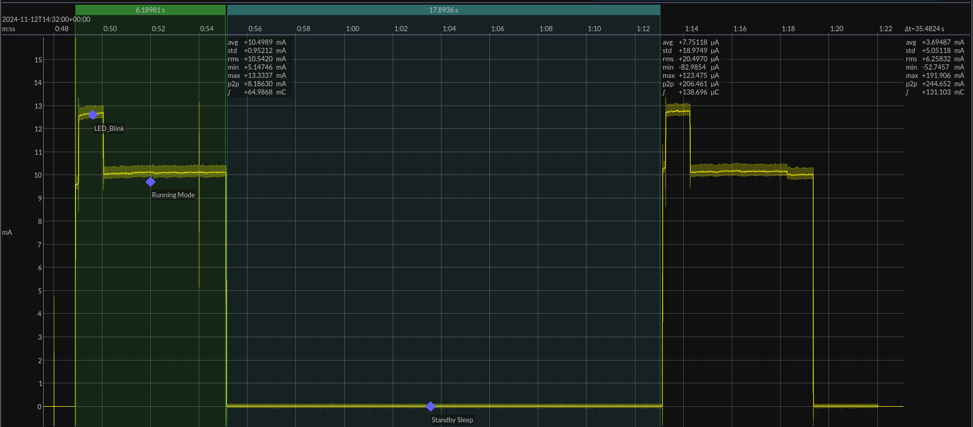
Energy profiling

Slide 13
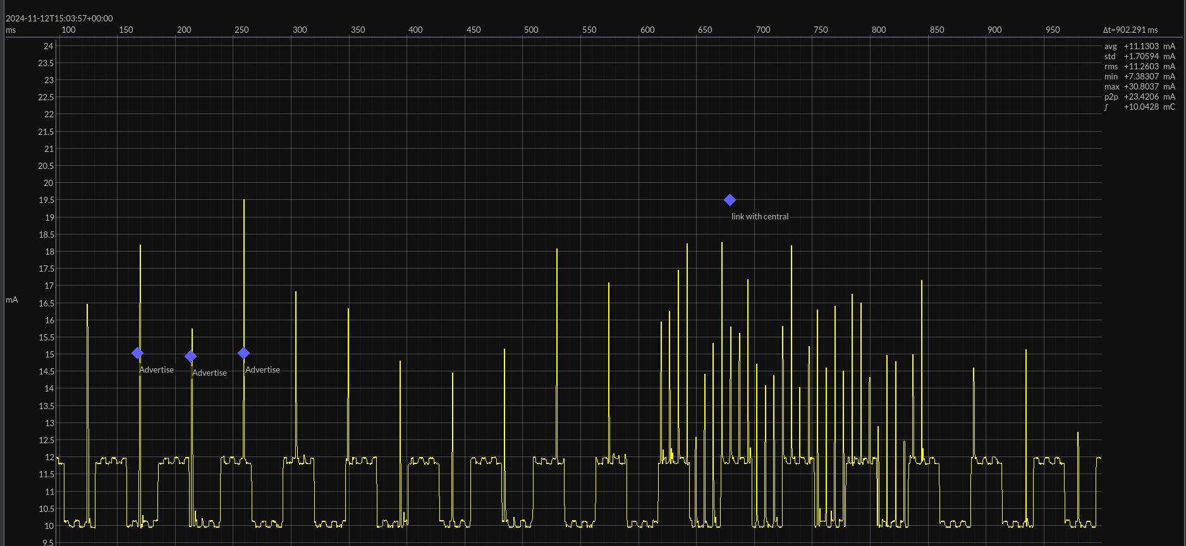
Energy profiling

Slide 14
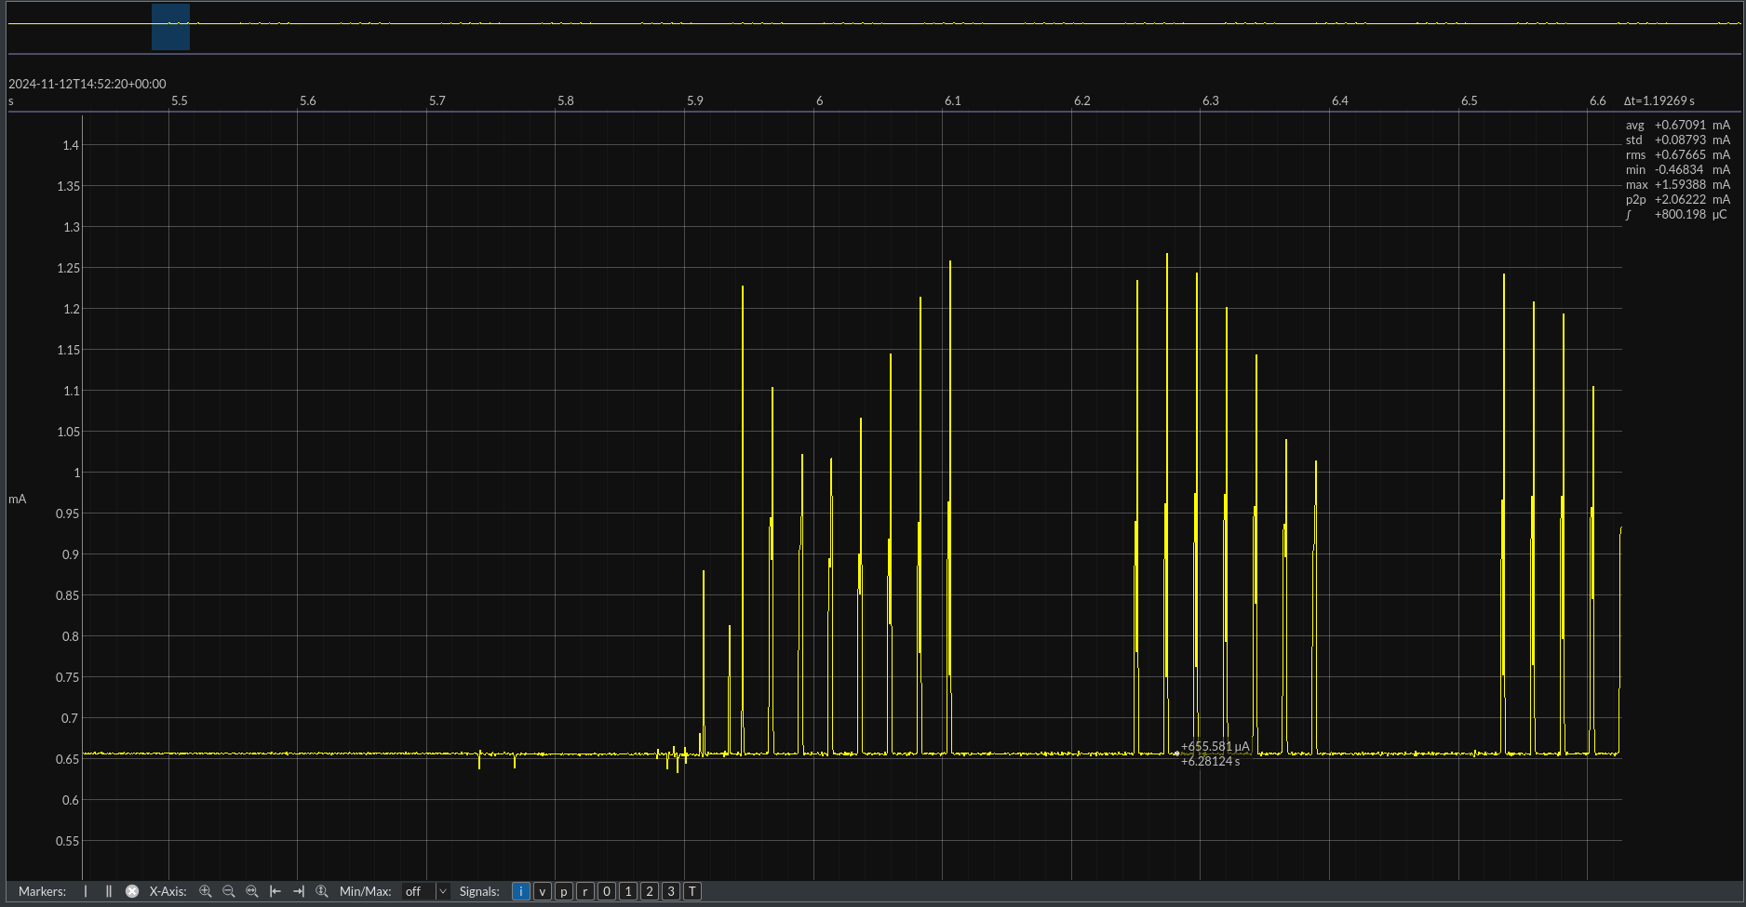
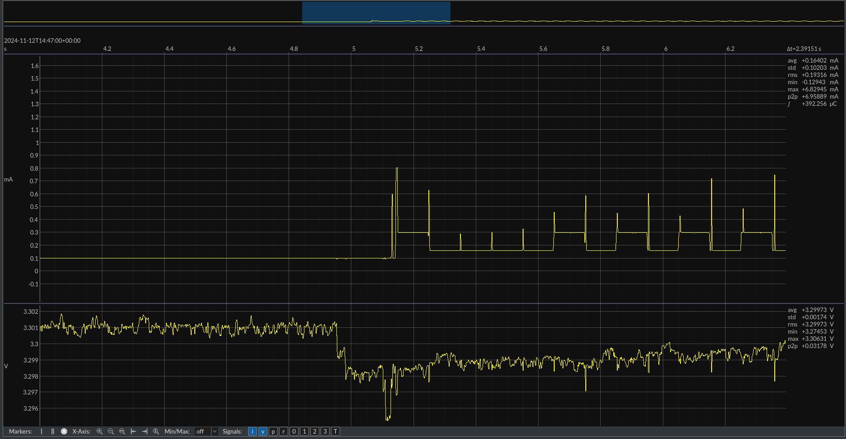
Energy profiling

Slide 15
Energy profiling
Module Average
Stm32 2.7mA
BLE 11mA
SHT40 0.67mA
LTR-329 0.23mA
LoRa …
Total 14.6mA

Slide 16

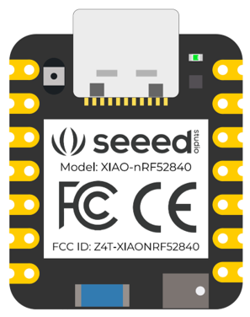

BLE comm
SSR 1
SSR 2
Advertising
Central

Slide 17
BLE comm
SSR 1
SSR 2
Central
Advertising

Slide 18
Lorawan ith moderated nodered server !!!

Slide 19
Gyroscope IMU

Slide 20
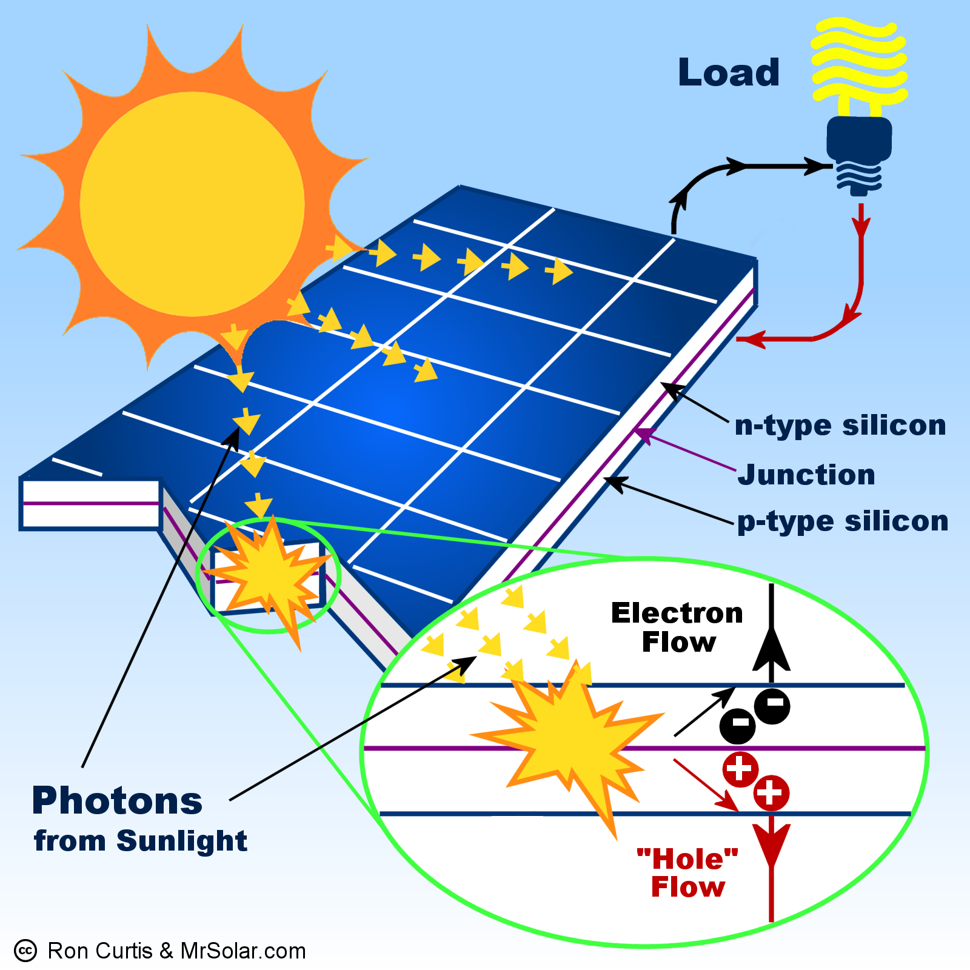
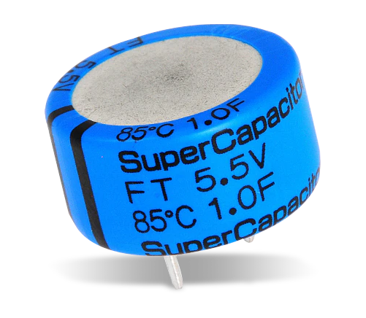
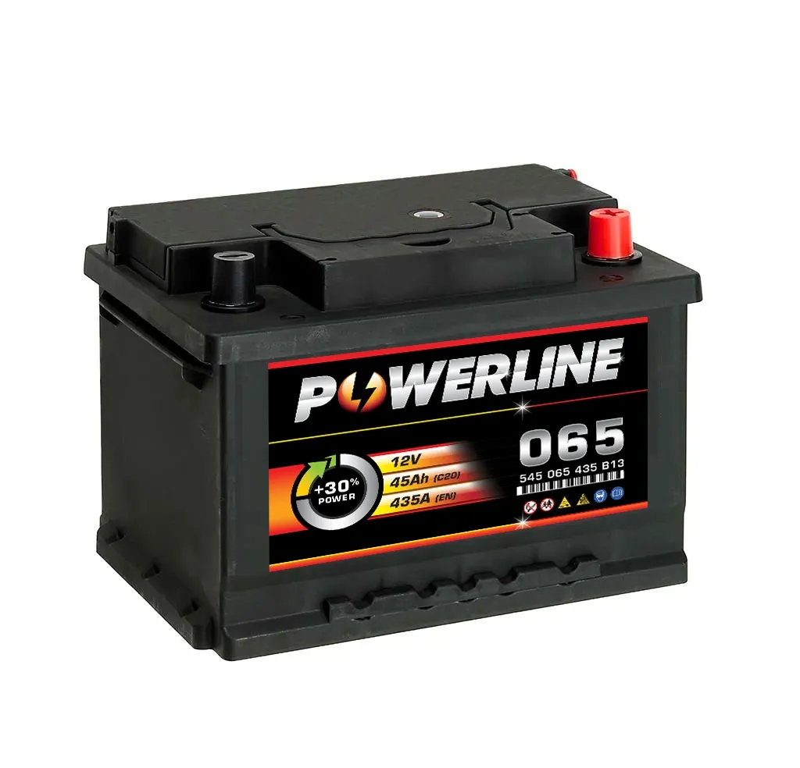
Enegry output managmenT

